Slide 1
Academy of Computer Science + Engineering
Welcome Back!

Slide 2
ECE 1004
Intro to Academic Writing
Ms. Blocker

Slide 3
Theme of course: Developing your Writing Persona
“A writer’s persona communicates to their audience who they are. It’s not only a chance to give writing a little personality, it is also an opportunity for writers to connect to readers by allowing them to imagine the person who wrote the text they’re now reading. A writer’s persona doesn’t need to encompass every single aspect of who they are as a person—rather, it’s a way of presenting a coherent identity to their readers through their language.”
Notes:
Purdue Writing Lab. “Creating Your Persona // Purdue Writing Lab.” Purdue Writing Lab, https://owl.purdue.edu/owl/general_writing/writing_style/style%20/creating_personas.html.

Slide 4
Course Components: Engagement:
This is a seminar rather than a lecture course. Therefore, the success of this class depends on the students as well as the instructor! Thoughtful discussion is an essential part of this class, and students will frequently work in groups of various sizes. Students are responsible for keeping up with the reading, contributing to class discussions in the form of analytical comments or questions, and to attending class regularly and on time.

Slide 5
Course Components: Reading:
We will focus on some strategies for approaching texts with an eye toward how to use the text to further thinking and writing skills. Annotation is an essential skill, so students are expected to come to class prepared to work through particular passages, bringing their thoughts, difficulties, and provisional understanding.

Slide 6
Course Components: Writing:
Students will write a number of responses this year. Each piece will contribute toward an overall thinking for a larger intellectual project of the students’ own choosing, and with their own unique perspective and approach.
Only the final papers, portfolio, and reflections will be counted toward the UConn ECE grade, but all written work will contribute to the summative academic grade for ACSE.

Slide 7
Course Components: Revision, Reflection, Peer Review:
Writing is, at its core, a collaborative effort. We never write in a vacuum. Instead, our academic writing should always have a purpose, an audience, and a sense of its social context. In keeping with this core concept of writing as a social act, students will receive feedback both from me and from their peers for each essay.

Slide 8
Course Components: Portfolio:
Students’ portfolio assignment, submitted at the end of the year, will contain revisions of selected writing assignments. They will need to SAVE ALL original writing assignments in order to complete these revisions. The portfolio allows students to recognize and show off their growth as a reader, writer, and thinker and act as evidence of meeting the course learning outcomes.

Slide 9
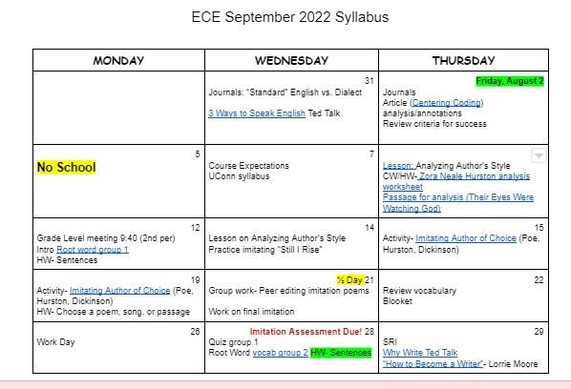
Monthly Syllabus

Slide 10
Types of Writing Assignments
Formal Essays: 2-6 pages
Responses/Reflections: 1-3 pages
Reaction Papers: Length will vary
Journals: This is a daily occurrence. Students will sustain writing for 10 minutes in the beginning of class every day. They may free-write or use the prompt provided.

Slide 11
Grading–Total Points
Each assignment will have a point value. Grade will be calculated based on dividing the points a student earns with the total points possible for the class (e.g. 1875/2000= 94%).
Examples:
Essays/Final Assessments= 100 points
Journals- 5 points each (30 points every other week).

Slide 12
Contact information
Email: sblocker@crec.org
Phone: 860-253-0274 X7873

